Slide 1
Baltimore Crime: Analysis and Models
Ion Barbus

Slide 2
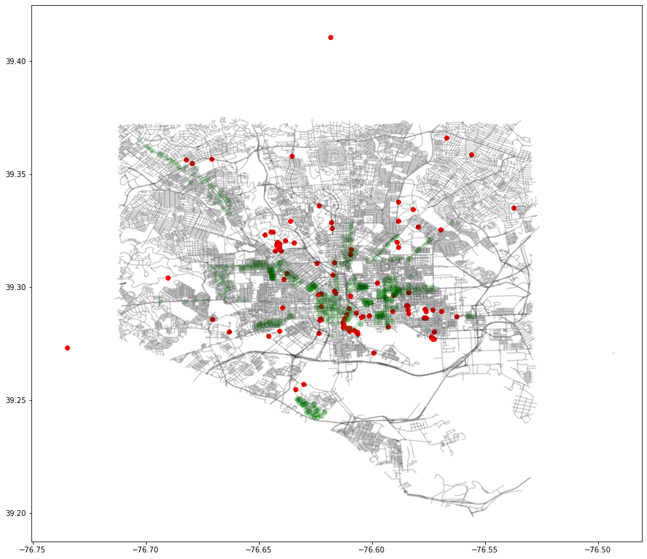
Event Dataset Preparation
Clean up location format
Derive entries from start and end dates
Change Data Objects
Analysis

Slide 3
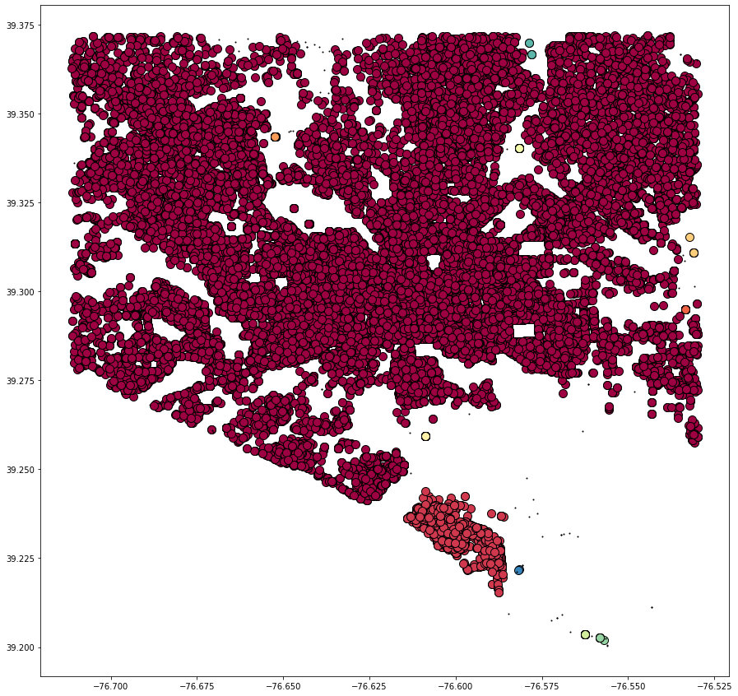
DBSCAN Model
All Baltimore Crime
Purpose: Find crime hotspots to better understand neighborhoods
DBSCAN
algorithm='ball_tree’
metric= 'haversine’
Sample size = 50k

Slide 4
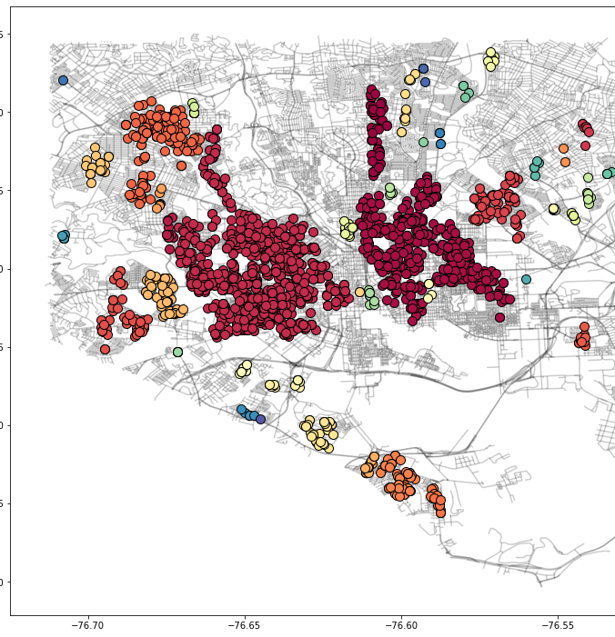
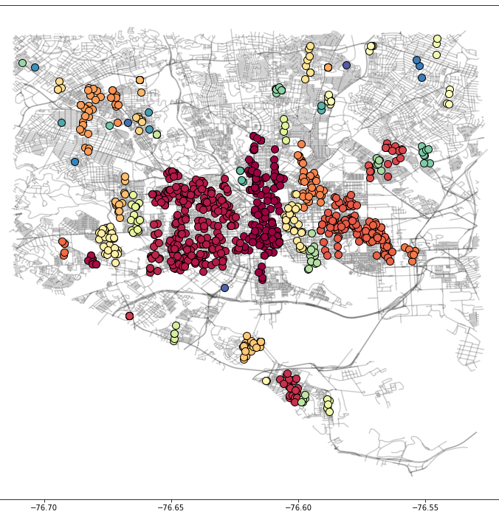
Baltimore Shootings
Baltimore Rape Hotspots

Slide 5
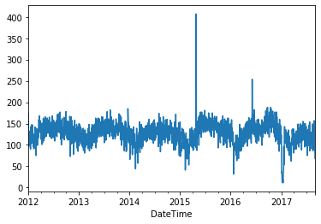
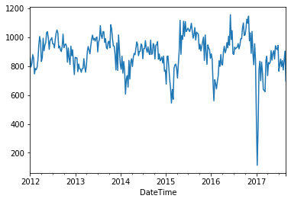
Timeseries Analysis
Daily
Weekly

Slide 6
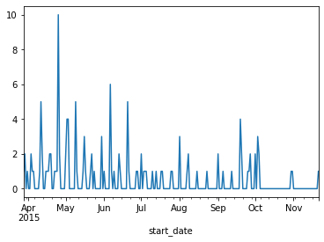
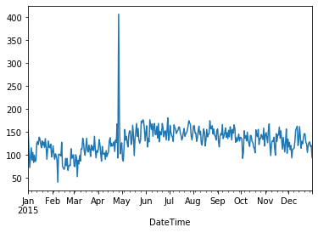
Cont.
Event by occurrences 2015
Crime occurances 2015

Slide 7
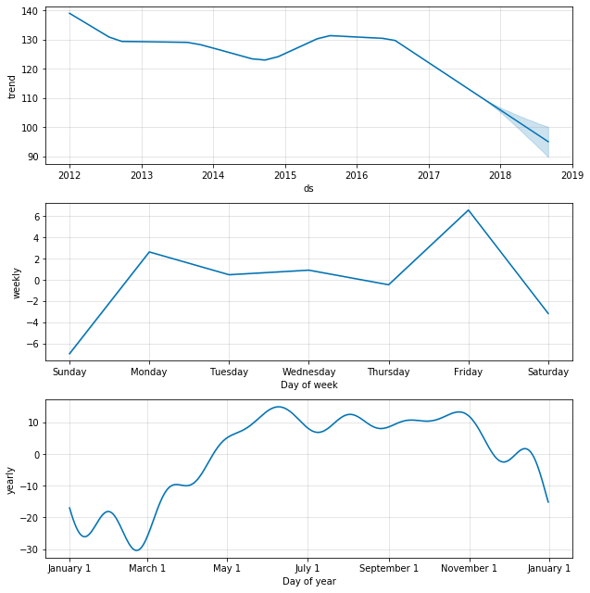
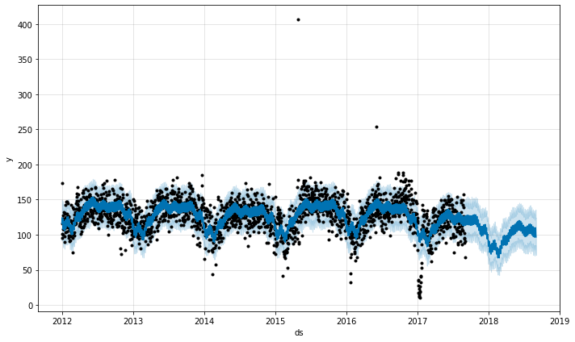
Timeseries Modeling
Facebook Prophet
Initial Forecasting
Event regressor
Holiday Regressor
Weather regressor
Validation

